Slide 1
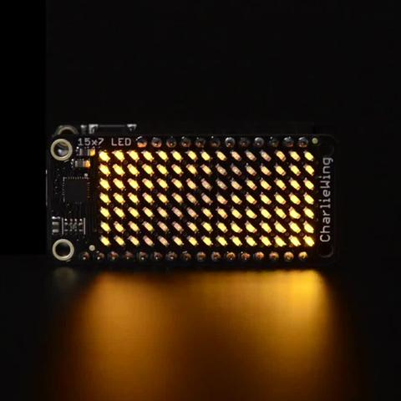
IS31FL3731 144-LED CharliePlex driver (0x74)
By :- Kuljeet Singh
Team Smart Health Tracker

Slide 2
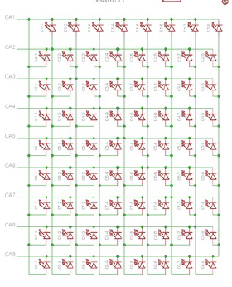
Introduction
Lightening system on Christmas has become a thing of old times now. It just like a; few bulbs which keep turning off and on simultaneously. So, something new and innovative needs to be in market now.
Charlieplex LED is a (16 X 9) matrix and every LED can be controlled individually. Hence, a large number of designs or patterns can be drawn with it.
In our system project(Next Semester), my sensor will be used as a display screen.

Slide 3
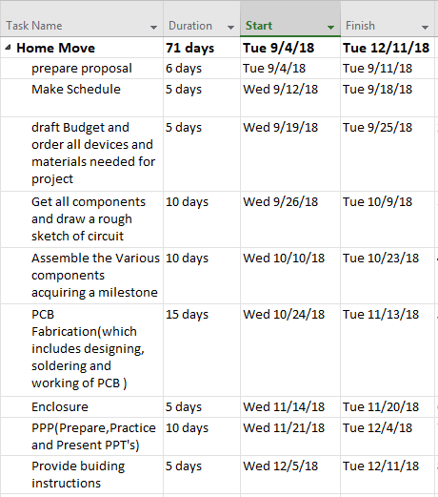
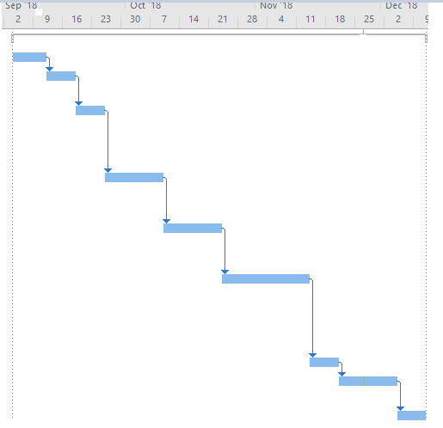
The Time Table

Slide 4
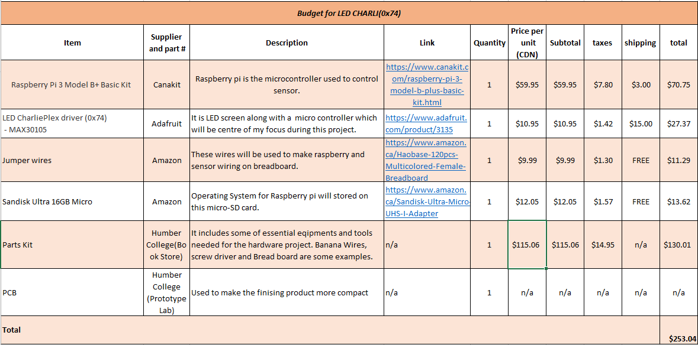
Budget

Slide 5
Sources
Tech 101 {Electronic Circuits}
Tech 150 {Electronic Devices and Circuits}
These two courses provided the vital information regarding the circuit and PCB.
Writ 220 {Technical Writing Skills}
Tech 153 {Technical C}
Ceng200 {Unix Scripting}
Using Raspberry-pi terminal would be impossible without this course.

Slide 6
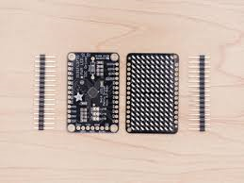
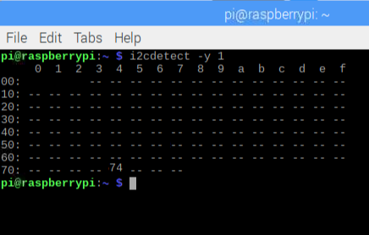
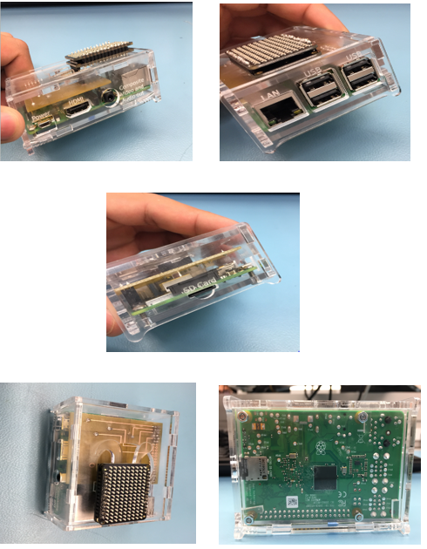
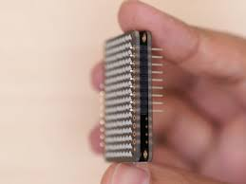
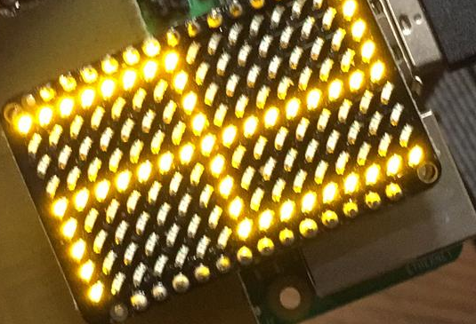
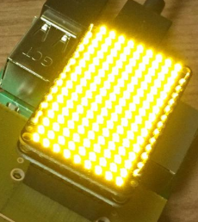
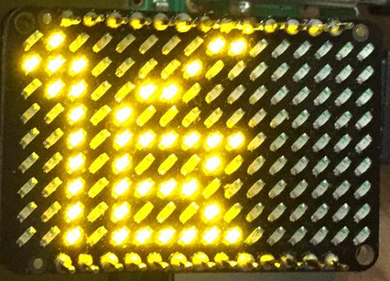
Some Glances

Slide 7
Thank you!!

